Slide 1
Comparison and Assessment of Housing and Income Appreciation Over The Past Decade
Courtney Gainor, Irwin Bahande Mier, Christopher Reutz, Kim Rones

Slide 2
Research Questions
How have housing prices recovered/increased in relation to the median household income in the US since the Great Recession?
How affordable is the San Diego area when compared to other metros across the nation?
In which San Diego County zip code areas would it be best to invest in a single-family home?
Notes:
[CHRIS]
Comparison and Assessment of Housing and Income Appreciation Over The Past Decade
Courtney Gainor, Irwin Bahande Mier, Christopher Reutz, Kim Rones
The great recession that occurred from late-2007 through early-2009 had a massively negative effect on home pricing in San Diego and across the country. The housing crisis that accompanied it was driven by sub-prime lending that resulted in a high volume of foreclosures.
Since the end of the recession, the housing market has recovered and stabilized. With the housing shortage - driven by high demand and low supply - driving up prices, our team sought to determine:
How housing values have recovered in relation to median household income growth nationwide over the past decade. How does San Diego County compare?
What is affordability like across the nation, the metros, and San Diego County in particular?
Drilling down to the local level, where might we find investment opportunities in San Diego County? Some areas have improved more than others, offering a better return-on-investment (ROI).

Slide 3
Research Questions
How have housing prices recovered/increased in relation to the median household income in the US since the Great Recession?
How affordable is the San Diego area when compared to other metros across the nation?
In which San Diego County zip code areas would it be best to invest in a single-family home?
Notes:
[COURTNEY]
On the macro level, Chris and Irwin just showed us that while San Diego area is an expensive place to live, with home value increasing on average at a faster rate than income, it is still a strong market to get into if you have the means. We chose to focus on San Diego County because that is where we all currently live.
So now that we have seen how San Diego ranks nationally on the metro level, we can dive in deeper to the micro side of things by looking at the data organized by zip code in order to answer our last research question: “In which San Diego County zip code areas would it be best to invest in a single-family home?”.
To answer this question, we decided to look at data for the time directly following the Great Recession up until now, as home prices took a huge dip at that time before they began to recover. By looking at this section of data in our recent past, we can make more accurate conclusions regarding current market trends.

Slide 4
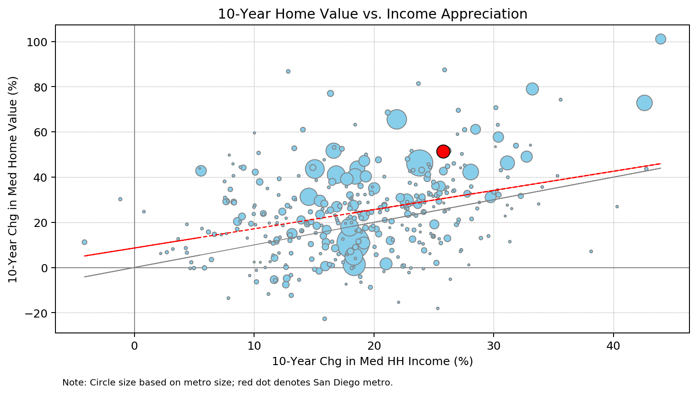
10-Year Home Value vs. Income Appreciation
The percentage change in median home value is compared the percentage change in median household income over a 10-year period.
The plotted metros are a sample of 369 metropolitan statistical areas (MSAs).
The scale of each point is based on the metro population size.
The San Diego metro is noted in red.
The gray line shows where income and home value have increased at the same rate (i.e. x=y).
The red regression line shows the fit which nearly follows a one-to-one overall trend with home appreciation slightly more than income appreciation.
The San Diego MSA is noted above in red. It is the nation’s 17th largest metro with a population of 3.3 million.
San Diego saw a 10-year growth in home values of 51.3% and median HH income of 25.8%.
Notes:
[CHRIS]
We started off by pulling data from Zillow’s data research and the U.S. Census Bureau (CB). Zillow maintains datasets for 933 metros plus the US as a whole for median household income and median home value.
The data in both sets is quarterly time series. A third Zillow file provided a “crosswalk” between the Zillow metro data and the CB population by metro using a unique CB defined ID. The tables were all joined into a dataframe which calculated the 10-year (Q4 2018 vs. Q4 2008) change in median household income and home value. The Q4 2008 quarter is approximately where housing prices bottomed-out during the last recession.
Metros missing data were dropped from the analysis, yielding a sample of 369 metros. The dropped metros tended to be smaller metropolitan areas; the largest 197 metros ranked by population were ALL represented.

Slide 5
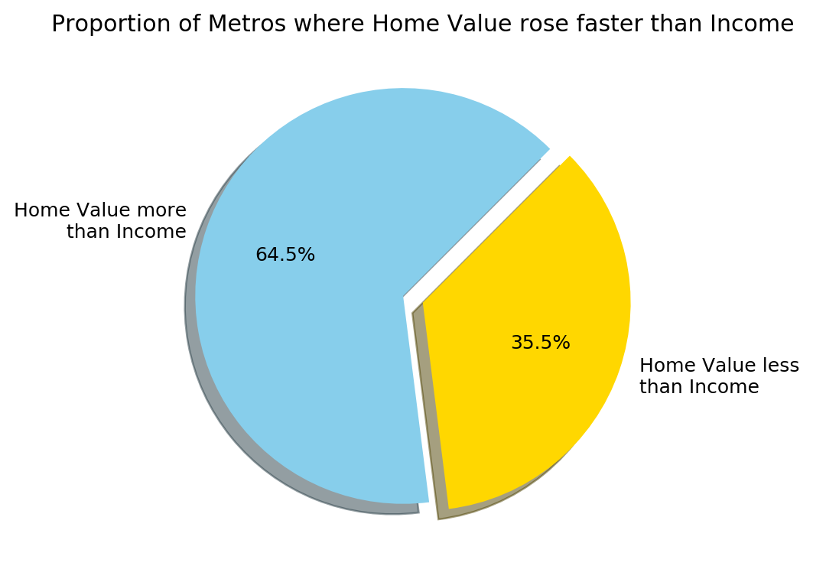
10-Year Home Value vs. Income Appreciation
Most metros tended to have greater home vs. income appreciation.
Of the 369 metros, nearly two-thirds (238) experienced home values increasing faster than median HH income.
Home appreciation tended to surpass income appreciation in most of the largest metros.
19 of the largest 25 metros had greater home appreciation, 5 had greater income appreciation, and Washington DC appreciated equally.
New York (10.8% v 18.3%), Chicago (1.3% v 18.4%), and Philadelphia (4.9% v 18.3%) were notable exceptions.
Notes:
[CHRIS]
From the metro areas that appeared on the scatter plot, most of them saw a greater change in home appreciation versus their income levels. This tells us that house prices have rebounded faster than the income levels of those who lived in that metro area. This is especially true in 19 of the largest metro areas. If you live in places like San Francisco, Philadelphia, or Dallas, the home prices in your area increased faster than your income.

Slide 6
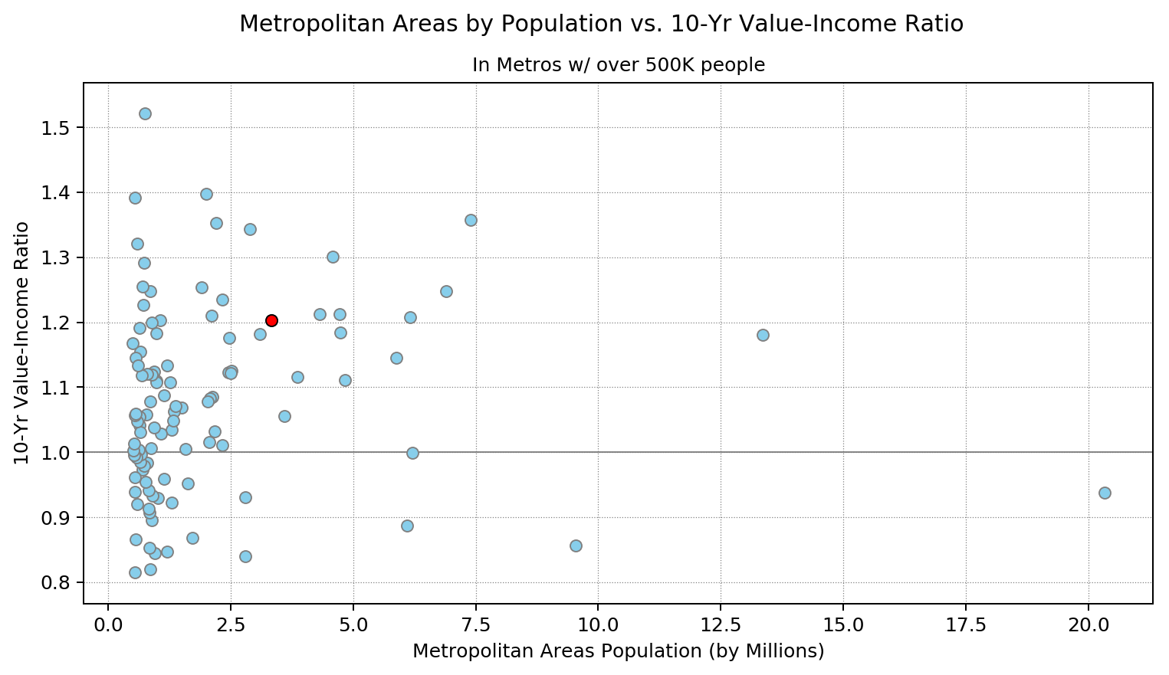
Home Value vs. Income Appreciation by Metro Size
We compared the ratio of home value vs. income based on metro size.
Only larger metros with a population of 500,000 or more are included - a total of 107 metros.
The US average is 1.05, nearly equal appreciation nationally.
The US average his is based on the entire population of 933 metros.
New York MSA is on the far right with a 20.3 million population and a 0.94 ratio.
San Diego MSA - shown in red - ranked 20th across all metros with a 1.20 ratio.
This put San Diego in the top quintile for larger metros.
Notes:
[IRWIN]
Then we did a closer inspection on the value-income ratio by metro area vs their population, but we only analyzed metro areas that had a population of half a million or over. A ratio of over 1 indicates that house price levels have appreciated more than income levels. On the far right you can see the New York MSA with a ratio of 0.94, indicating a ratio of under 1.

Slide 7
Research Questions
How have housing prices recovered/increased in relation to the median household income in the US since the Great Recession?
How affordable is the San Diego area when compared to other metros across the nation?
In which San Diego County zip code areas would it be best to invest in a single-family home?
Notes:
[COURTNEY]
On the macro level, Chris and Irwin just showed us that while San Diego area is an expensive place to live, with home value increasing on average at a faster rate than income, it is still a strong market to get into if you have the means. We chose to focus on San Diego County because that is where we all currently live.
So now that we have seen how San Diego ranks nationally on the metro level, we can dive in deeper to the micro side of things by looking at the data organized by zip code in order to answer our last research question: “In which San Diego County zip code areas would it be best to invest in a single-family home?”.
To answer this question, we decided to look at data for the time directly following the Great Recession up until now, as home prices took a huge dip at that time before they began to recover. By looking at this section of data in our recent past, we can make more accurate conclusions regarding current market trends.

Slide 8
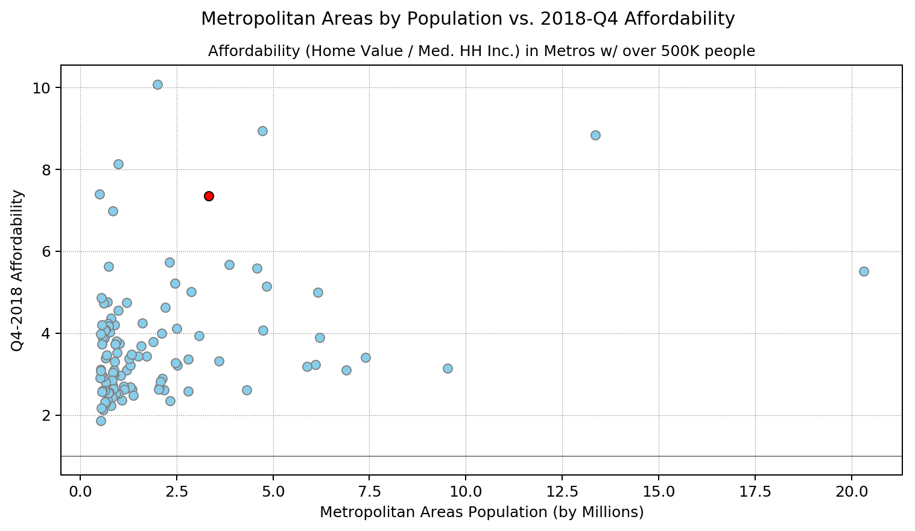
Current Home Affordability by Metro Size
We compared current affordability (Q4 2018) in the largest metros.
Affordability is defined as a ratio of current home value over current median HH income.
The US average of 3.54 means that home values are 3.54 times greater than annual income.
Of the 107 largest metros, San Diego ranked 6th with 7.36.
San Jose (10.08), San Francisco (8.94), Los Angeles (8.84), and Honolulu (8.13) were the least affordable.
Metro size was a significant factor with Los Angeles (2nd), San Francisco (11th), and San Diego (17th) amongst the most populous metros.
Notes:
[IRWIN]
We then analyzed the affordability of a current home in the same metro areas. In this case, we defined it as a ratio of current home value over current median household income, and the national average is 3.54. Home values on average are 3.54 times greater than annual income. Looking at San Diego, we can see the it ranks 6th in least affordable housing markets in relation to income. The size of the metropolitan area was also a factor, as the most expensive metro areas in the nation also happened to be the largest.
Outro -
San Diego market is still a good market to get into despite what this graph shows because….dive into a more micro level analyzing the different zip codes for San Diego and see how the housing market is doing within the county

Slide 9
Research Questions
How have housing prices recovered/increased in relation to the median household income in the US since the Great Recession?
How affordable is the San Diego area when compared to other metros across the nation?
In which San Diego County zip code areas would it be best to invest in a single-family home?
Notes:
[COURTNEY]
On the macro level, Chris and Irwin just showed us that while San Diego area is an expensive place to live, with home values increasing on average at a faster rate than income, it is still a strong market to get into if you have the means. We chose to focus on San Diego County because that is where we all currently live.
So now that we have seen how San Diego ranks nationally on the metro level, we can dive in deeper to the micro side of things by looking at the data organized by zip code in order to answer our last research question: “In which San Diego County zip code areas would it be best to invest in a single-family home?”.
To answer this question, we decided to look at data for the time directly following the Great Recession up until now, as home prices took a huge dip at that time before they began to recover. By looking at this section of data in our recent past, we can make more accurate conclusions regarding current market trends.

Slide 10
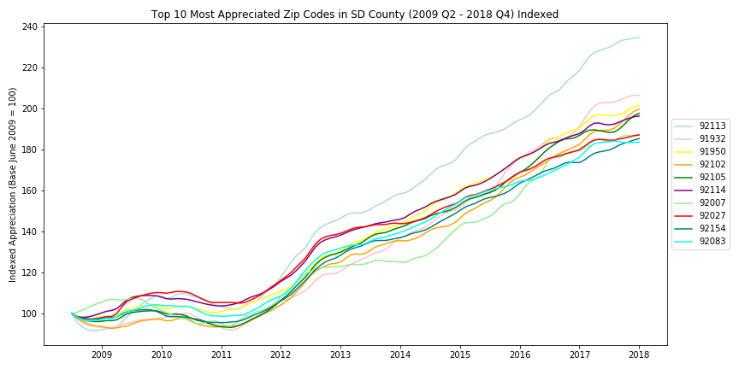
Top 10 Appreciated Zip Codes in SD County (Indexed)
(2009 Q2 - 2018 Q4)
Compared 87 of the zip codes in SD County
Queried the most appreciated zip codes in SD County since the end of the Great Recession
Graphed top 10
Indexed them with base = 100
92113 had highest appreciation rate
Notes:
[COURTNEY]
So, we started our data exploration by pulling a dataset from Zillow’s research which contained median estimated home value information for the major 15,616 zip codes in the US on a monthly time series. We extracted the zip codes for San Diego County and placed them in a dataframe with which we calculated the appreciation rates from the end of the Great Recession, June 2009, to now, the most recent available data being December 2018.
We ranked this data by appreciation rate and of these 87 zip codes, we analyzed the top 10. There are more than 87 zip codes in San Diego County, but some of them were too small of a population to assess, or were PO Boxes, so Zillow did not have their data.
Next, we indexed those same top 10 most appreciated zip codes. We started the base year, June 2009, the official end of the Great Recession at 100 so that as time passes, we can see how the median home values for each month compare to the median home price of the starting year (here). When points are below 100, that means the median home value that month was less than what it was at the end of the Great Recession, such as around this dip, and when the points are above 100, there is recovery, (as seen here). The Barrio Logan/Logan Heights area (the blue line on top) was the zip code that appreciated the most, which this graph clearly shows.

Slide 11
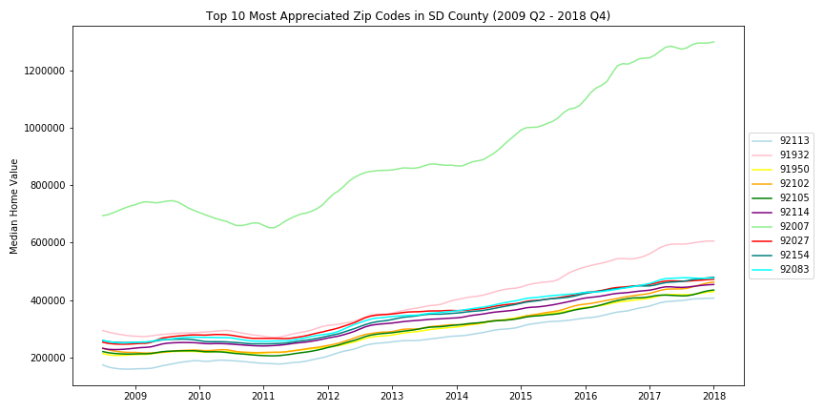
Top 10 Appreciated Zip Codes in SD County
(2009 Q2 - 2018 Q4)
Looked at Median Home Value vs. Time from end of Great Recession to now
Encinitas, 92007, was the outlier due to the high cost of housing (ranked 7 for appreciation)
Barrio Logan / Logan Heights / SE SD area, 92113, has lowest cost of housing (highest appreciation rate)
Notes:
[COURTNEY]
Then, we decided to take those top 10 appreciating zip codes, and take a look at how the actual median home values fluctuated over time. Encinitas housing prices (the green line up top) are much higher than the rest of the top 10 zip codes, causing it to be an outlier. Even though 92113 (Barrio Logan/Logan Heights/South East San Diego area) is the lowest line (this blue one) on the graph, it still had the highest appreciation rate. Based on this representation of the data, it appears that 92113 is currently the best market to invest in a single-family home in San Diego County. It has the highest appreciation rate, meaning that the value of the homes in this area increase on average at a faster rate than homes in other areas of SD County. And in addition to this, it is also the area with the lowest cost of housing (of these 10) meaning that it is a great market that is also easy to get into. Since these are the top 10 highest appreciating zip codes, any of them would be great areas to look into purchasing residential property, but as you can see here, where you are able to look may be determined by how much you are willing to spend.

Slide 12
Top 10 Appreciated Zip Codes in SD County
(2009 Q2 - 2018 Q4)
92113 - Barrio Logan, Logan Heights, and part of SE SD
91932 - Imperial Beach
91950 - National City, Chula Vista, Lincoln Acres
92102 - Stockton, Grant Hill, Mount Hope, Southpark, Webster
92105 - Islenair, Ridgeview, Castle
92114 - South Encanto, North Bay Terraces, Alta Vista, Lomita
92007 - Encinitas
92027 - Escondido, Valley Center
92154 - Imperial Beach, Chula Vista
92083 - Vista
Notes:
[COURTNEY]
Here we can see where the top ten zip codes are. They are actually centered mostly around San Diego Bay (right around here), with Encinitas (near the ocean), Escondido, and Vista (more inland) as exceptions.

Slide 13
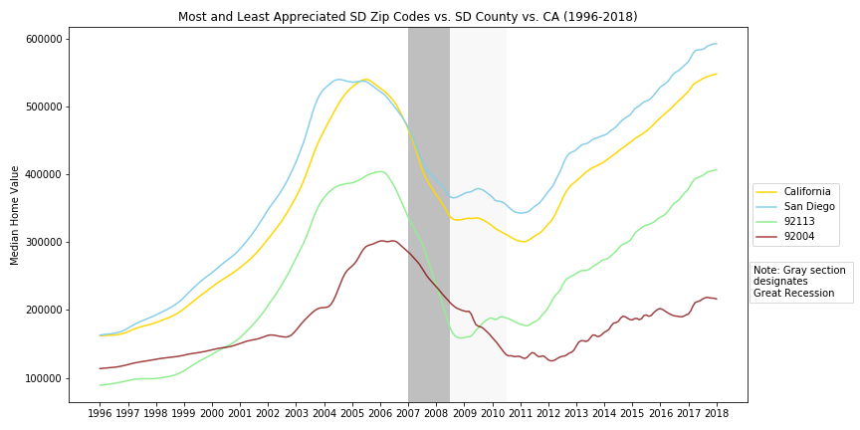
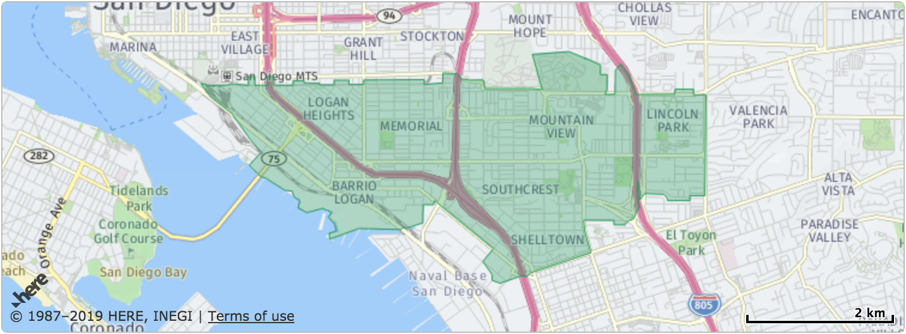
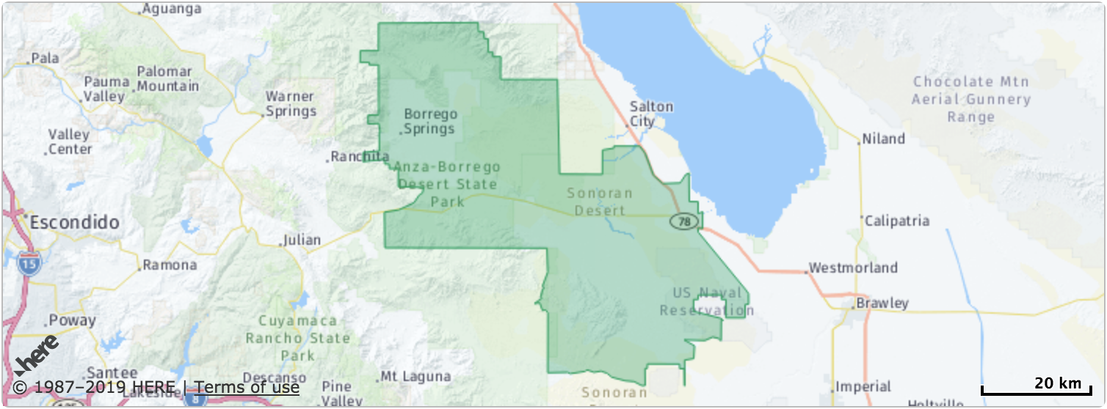
Highest and Lowest Appreciated ZIP Codes in SD County Compared to County and State Before, During, and After the Great Recession (1996 Q12 - 2018 Q12)
92113 (Barrio Logan and part of South Eastern San Diego)
92004 (Borrego Springs)
Notes:
[KIM]
We compared the median home values of the most and least appreciated homes zip codes in SD vs with the the average appreciated value the averages for SD County vs the average appreciated value in and CA. Here, we decided to make maximum use of the data that was available from Zillow, to see if we could notice any other trends. We included data going all the way back to 1996, so that we could have a broader perspective on how median home values fluctuated before, during, and after the Great Recession. The gray line section in the center represents the Great Recession, which lasted from Dec 2007 - June 2009. It took a couple of years to recover after the recession as home prices continued to dip until 2011.
While the lines all seem to follow similar trends of dropping and recovering, we can make more conclusions by looking at this graph. It appears that our highest and lowest appreciating zip codes in San Diego County both had median home values that were consistently less than the averages for the county and state.
Our highest appreciating zip code actually started off with lower home values than the lowest appreciating area, but climbed much higher, especially in recent years. During the Great Recession, the home values of the two were very close, even overlapping for a brief stint.
But while Barrio Logan/ South Eastern San Diego (92113), the green line here, had the highest appreciation value, progressing from a median value of 163,000 value to a median value of 404,000 value with an appreciation rate of 134.58% (development in area), Borrego Springs had the lowest appreciation value in SD, barely appreciating at all at a 2.7% appreciation rate. Fun fact: the second lowest appreciating zip code was 92067, Rancho Santa Fe, with median home values consistently higher than 2 million.
This representation of the data shows us that median home value does not necessarily determine the rate of appreciation. While 92113 appears to be the best current single-family home investment due to its very high appreciation rate since the Great Recession, and it’s relatively low median home value (less than that of the county and state), there are other variables that may factor into how attractive a particular market may be.

Slide 14
Future Analysis
Ranking school district test scores/performance
Number of parks
Low crime rate
Proximity to natural landmarks (beach/mountains/lakes)
Notes:
[KIM]
Our project first focused on determining a good investment based on a comparison of Median Household Income, Median Home Value, and Population Size on the metro level. Once zoning in to our county and using zip codes for zoning, we then used only Median Home Value over time as our variable to determine our pick for best investment. Similar projects could be done with a plethora of other factors, which we expect would correlate with the data we have found so far. Some opportunities for future analysis in the realm of our project are listed here. [read bullets on slide]
Thank you all for your time. Now we would be happy to take any questions!

